Slide 1
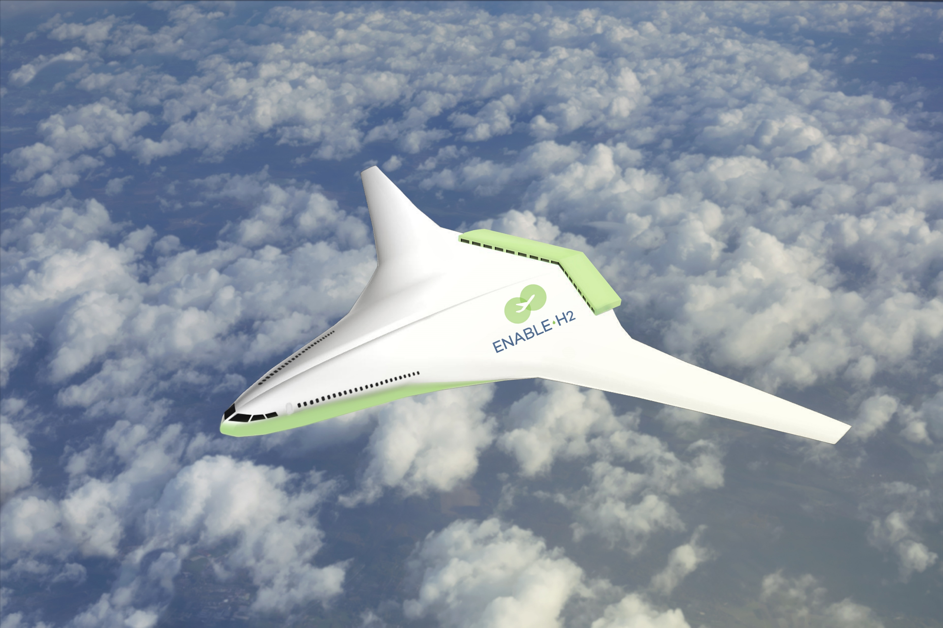
Decarbonising Civil Aviation Protecting the Environment and Economic Growth and Thermal Power & Propulsion MSc Opportunities
The need to protect the environment is very urgent. Simultaneously, we must secure continuing economic growth. Great strides have been made to eradicate poverty. Although there has been great progress there is still a huge task that remains to be done. Thus, sustainability must bring concurrent advances in environmental and socioeconomic performance. This challenge can be met with targeted technology investments. The presentation will explain why electrification and hydrogen are very good choices for civil aviation. It will also encompass a description of replacing current aircraft in fully decarbonised scenarios and some wider implications. Participation of Thermal Power & Propulsion MSc projects will be mentioned.
Image Courtesy of EU H2020 project Enable H2
Prof Pericles Pilidis - Director Thermal Power MSc, FRAeS, UK Representative ISABE
Cranfield University – Propulsion & Thermal Power - Presenting a team effort

